Slide 1
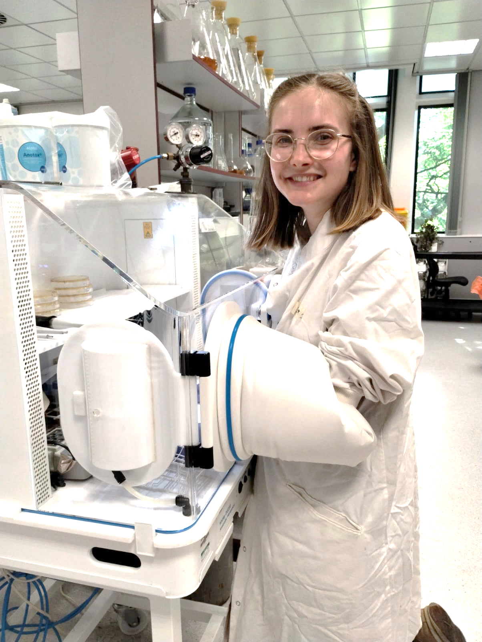
Multiple evolutionary pathways lead to vancomycin resistance in Clostridioides difficile
Lizah van der Aart
Colour | Bc
 | 1
 | 2
 | 3
 | 4
 | 5
 | 7
 | 8
 | 9
 | 10
 | 11
Jessica E Buddle¹, Rosanna C.T. Wright², Claire E Turner¹, Roy R. Chaudhuri¹, Michael A. Brockhurst², Robert P. Fagan¹
¹University of Sheffield, ²University of Manchester
Jbuddle2@sheffield.ac.uk
← Paper
Background
CV website →
V
New chain end
Treatment of C. difficile infection in the UK primarily relies on the glycopeptide antibiotic vancomycin.
We experimentally evolved replicate populations of C. difficile to understand the evolutionary dynamics and molecular mechanisms underpinning vancomycin resistance.
V
L-Ala
D-Glu
A2pm
D-Ala
D-Ala
Transpeptidase
V
Vancomycin
Don Whitley DG250
Glycosyltransferase
NAM NAG
Vancomycin resistance evolves rapidly in C. difficile during in vitro experimental evolution
Replicate line | End point MIC (µg/mL)
Ancestral | 1
Bc1 | 32
Bc2 | 16
Bc3 | 16
Bc4 | 16
Bc5 | 32
After 60 days (~250 generations), all populations had an apparent MIC of 16 or 32 µg/mL, however significant variation existed in isolates of the populations.
Two distinct pathways to vancomycin resistance
1 isolate clone from each population was sequenced.
Parallel evolution – mutations affecting the same gene arise independently.
Mutations in either dacS, a histidine kinase, or vanT, a serine-alanine racemase – suggesting two pathways to resistance.
Vancomycin resistant clones display reduced fitness
Growth
Sporulation
dacS increases expression of dacJ
dacJ encodes a D,D-carboxypeptidase
Cleaves the terminal D-ala
Reduced vancomycin binding sites.
WT
Resistant Isolate
….. Total count
___ Spore count
Population dynamics in evolving populations
Whole populations were sequenced at 3 time points.
dacS fixed early in the evolution, vanT arose later and reached fixation by P20 or 30.
X @BuddleJess
LinkedIn: https://uk.linkedin.com/in/jessicabuddle

